Slide 1



Slide 2
Introduction:
Toy universe is actually an entire universe of toys and children books right at the fingertips of the parents allowing them to provide their children with the best fun & play money can buy.
This site caters to the needs of every child by providing a two different approaches:
One is the e-commerce part in which they can buy toys and books
second is in which they can rent out toys and books and return them after a particular time-span.

Slide 3
Existing system:
As ecommerce sites are picking up in every direction providing people everything they want right at their doorstep without the need for anyone to leave the comfort of their homes.
Toy universe helps parents to meet the need of their children by providing an ecommerce platform where they can buy the toys and games according to their requirements

Slide 4
Proposed system:
Toy universe is just not an ecommerce site it also has a library where parents can rent the toys that are too big to keep in a home.
As children often get bored of playing with the same toys over and over again we felt the need to come up with a system that is integrated in such a way that it solves this problem.
Parents can buy a toy and when they have finished with it can returned and according to the time used and condition of it the price is adjusted.
They can also rent toys and books from our toy library where they have to scribe to a monthly, quarterly, half yearly and yearly plans. Once they have down this they are credited with points to their site account that they can exchange for toys or books

Slide 5
Modules
First Module: Online Store Management
This module consists of 4 sub-function:
Registration:
Every user has to register themselves and provide their full details.
Search:
The search function is a unique piece of art, where parents can search via age, type, skill etc. filtering the results according to their needs.
Browse:
Parents and children can browse through the thousands of products that are updated timely
Cart:
This module has a cart functionality

Slide 6
Second Module: Library Management
This module consists of 3 sub-function:
Registration:
Every user has to register themselves and provide their full details.
Membership Plan:
To entice customers more we have a points system in place, by what means is that means is that rather than dealing with cash for each transaction users trade points that they have purchased by scribing to one of the various plans available on the site.
Once a member has purchased a membership plan, according to the plan points are automatically credited to each of their accounts.
Pick-up Request
Once they have finish the period of the rental of a particular they have to order a pickup for the same.

Slide 7
Third Module: Blog
There is a blog which will contain topics that will help parents and guide them.
Fourth Module: Guides & FAQ
This module consists of 3 sub-function:
Guide:
There will be a detailed guide to help parents how the library system works.
FAQ:
Common questions asked by parents will be posted and well as answer to the same.

Slide 8
Technology Used:
Front End : HTML, CSS, JQuery, PHP
BackEnd: SQL

Slide 9
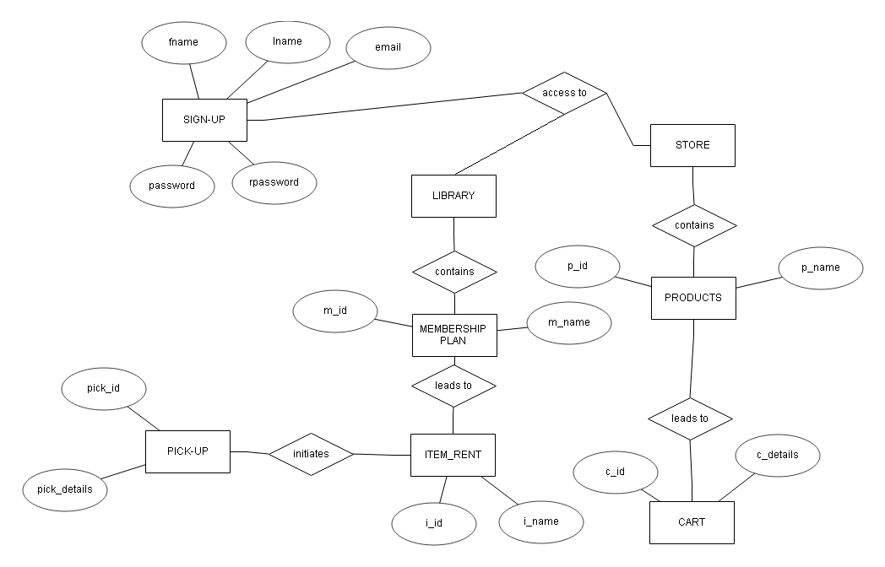
ER Diagram

Slide 10
DFD Context Level
0.0
TOY UNIVERSE
Store
Registration Details
Registration Details
Library
Acknowledgement
Acknowledgement
Browse Product
Plan Details
Display Products
Choose Plan
Add to cart
Browse Product
Display Products
Rent Product
Request Pickup

Slide 11
DFD 1st Level
1.0
ONLINE STORE MANAGEMENT
DETAILS OF CUSTOMERS
REGISTRATION
ACKNOWLEDGEMENT
USER ID AND PASS
CUSTOMER DETAILS
USERS
ACCESS GRANTED
ACKNOWLEDMENT
CATEGORIES
SEARCH
DISPLAY PRODUCT
PRODCTS DETAILS
STORE TOYS/BOOKS
BROWSER
DISPLAY PRODUCTS
RETRIVE PRODUCTS

Slide 12
DFD 1st Level
2.0
ONLINE LIBRARY MANAGEMENT
DETAILS OF CUSTOMERS
REGISTRATION
ACKNOWLEDGEMENT
USER ID AND PASS
CUSTOMER DETAILS
USERS
ACCESS GRANTED
ACKNOWLEDMENT
PLANS SELECTED
CATEGORIES
SEARCH
DISPLAY PRODUCT
PRODCTS DETAILS
LIBRARY TOYS/BOOKS
BROWSER
DISPLAY PRODUCTS
RETRIVE PRODUCTS
RETRIVE PRODUCTS
RETRIVE PLANS
PLANS
CHOOSE PLANS
MEMBERSHIP PLANS

Slide 13
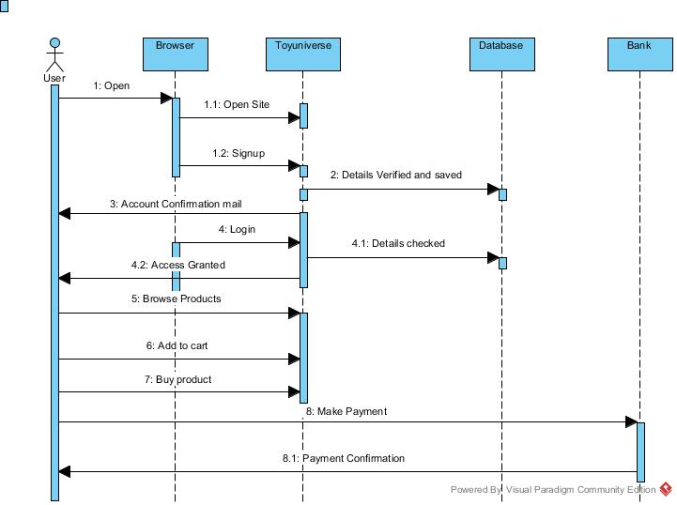

Slide 14
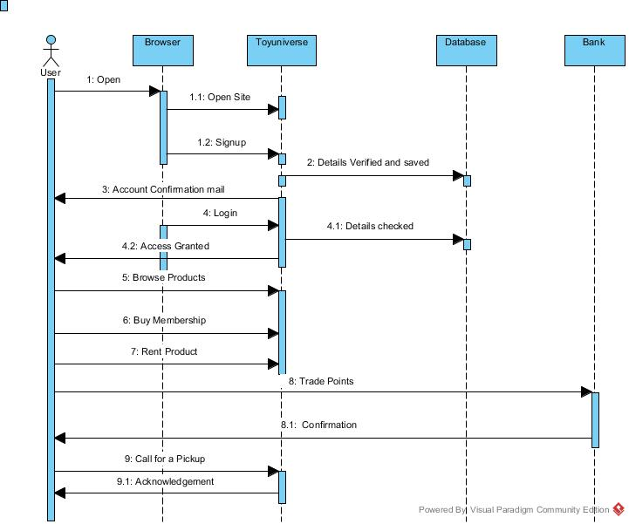

Slide 15
Thank You

